Slide 1
J-E-S-U-S
Jesus is His Name

Slide 2
J-E-S-U-S
There was a baby named Jesus born
on Christmas day ooo
J-E-S-U-S J-E-S-U-S J-E-S-U-S
And Jesus was His name-o!

Slide 3
J-E-S-U-S
There was a baby born to Mary Jesus was His name o!
J-E-S-U-S J-E-S-U-S J-E-S-U-S
And Jesus was His name-o!

Slide 4
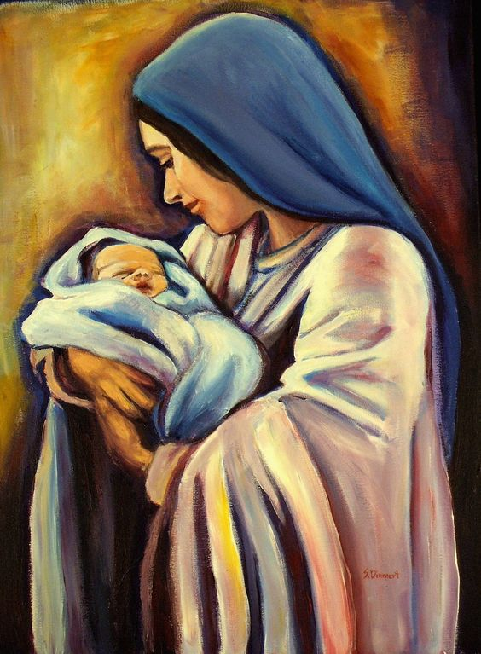
J-E-S-U-S
VOCABULARIES: Mary : mẹ của Chúa Jesus
born to : sinh từ

Slide 5

J-E-S-U-S
VOCABULARIES: Christmas: lễ giáng sinh

